Slide 1
PRPL mesh
Overview

Slide 2
Executive summary
Intel has contributed its mesh framework into prplMesh
  Designed for production-quality with very strict security requirement
  Intel invested many man years to develop, test, document, flow diagrams,…
  Includes a proven full Mesh solution (Controller & Agent running on actual HW)
Intel will support prpl
  Training/Bootcamp and on-going support
  Dedicated team contributor/maintainers to keep developing with PRPL
PRPL own the project and will adapt it into prplMesh
  Convert flows to EasyMesh standard, certify

Slide 3
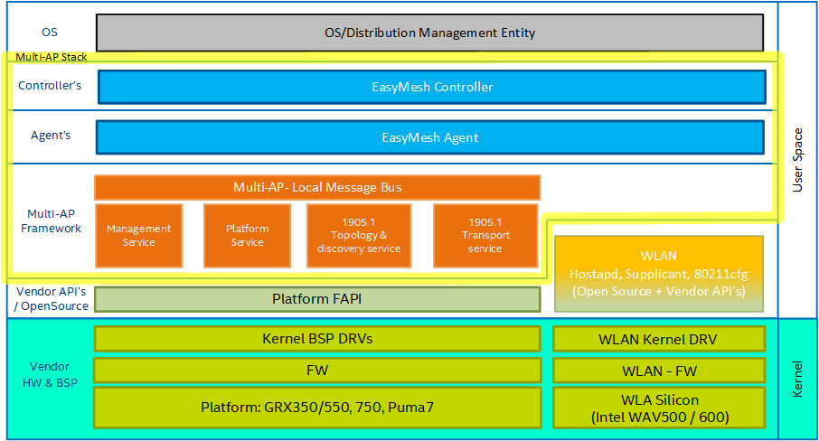
PrplMesh - System arch partitioning

Slide 4




PRPL EasyMesh architecture
OS
/
Distribution Management Entity
Algorithms
Algorithms
Features
PRPL mesh Controller
TFL
PRPL mesh Agent
TFL
Management
BML
BTL
BTL
PAL
BWL
API
?
s
Multi
-
AP Framework
Local Message Bus
(
)
XSub
-
XPub
MPL
TFL
TFL
TFL
WLAN
1905
API
.
1905
1
.
Management
1
Platform
Topology
Transport
&
D
-
Service
Service
WPAL
discovery service
service
Hostapd
Supplicant
Netlink
PPL
Network Stack
OS
WLAN Driver
/
Distribution
(
cfg
80211
L
)
2
–
Raw Socket
FAPI
TFL
–
TLV factory Library
BML
Sheared
WLAN
–
BeeRocks Management Library
Framework
Controller/agent
PAL
–
Platform Abstraction Library
BTL
–
BeeRocks Transport Library
(
TX
/
RX CMDU
Legend
Library
)
PPL
–
Platform Plugin Library
BWL
–
BeeRocks WLAN Library
MPL
–
Management Plugin Library
D
-
WPAL
Local BUS IPC
API
–
Dynamic WLAN Platform Library

Slide 5
Main benefits of PRPL’s new EasyMesh stack (1/3)
Fully featured Mesh solution (including Controller)
  Includes optimized and tested Controller decision-making algorithms
  Working and tested Mesh system
    mobility / steering, channel selection, statistics, network map, BH optimization, DFS
Security - Intel requires very strict security standards
  Solution arch complies with Intel’s strict security requirements for product grade
    Threat model approval, service and permission segregation (compartmentalization), security code reviews, malware scans, static code analysis and more…

Slide 6
Main benefits of PRPL’s new EasyMesh stack (2/3)
IEEE 1905.1 stack
  Tested Intel proprietary stack, built for 32bit systems with all EasyMesh features
    fragmentation, MID tracking, cookie, multicast, etc..
Scalable architecture
  Designed to be easily ported to multiple SDK’s / Wi-Fi vendors / HW platforms
    Using Platform, Wi-Fi and Management Adaptation Libraries
    Already quickly ported to RDK-B (running) from UGW (OpenWRT-based)
  Micro-Service approach
    Best fit for open source with dispersed community of multiple developers / geos

Slide 7
Main benefits of PRPL’s new EasyMesh stack (3/3)
  TLV Factory Library
    Major infrastructure capability, enabling automatic creation of 1905 message TLV Classes
      Replaces monolithic BBF 1905 with a bus-based service (also used for IPC)
    Designed to easily add / modify message structures
      All R1 messages supported
      R2 messages can be added trivially
      YAML inputs converted into C++ Classes with APIs to form & parse 1905 messages & TLVs
      Internal messaging reuses the TLV factory (via YAML)
      Serializes into any specific structure (unlike Google ProtoBuf) such as 1905
        Valuable as standalone open-source

Slide 8
PRPL mesh agent/controller – high level overview

Slide 9
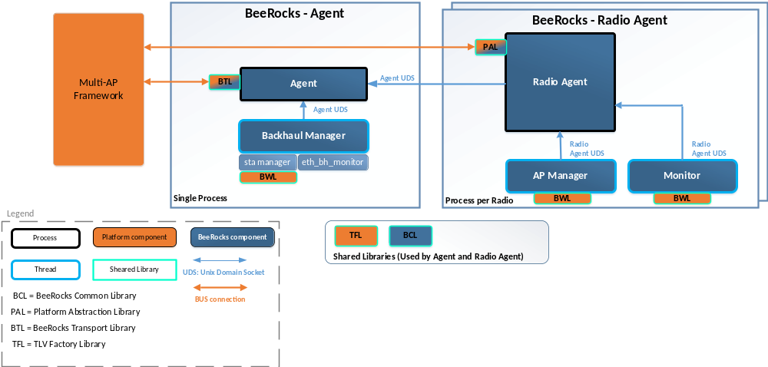
High-level Agent Architecture

Slide 10
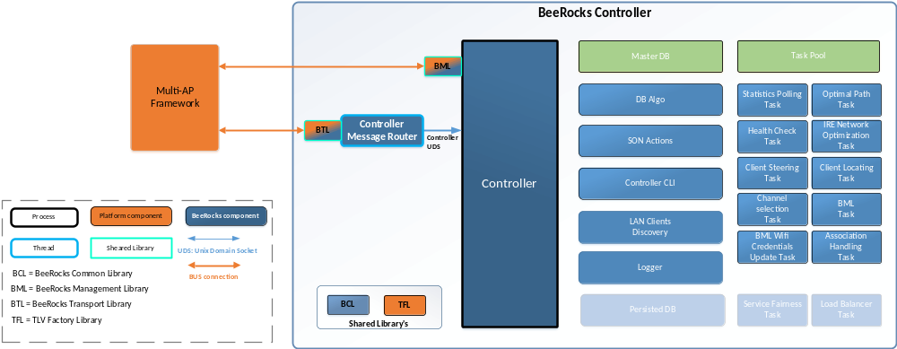
High-level Controller Architecture

Slide 11
BACKUP

Slide 12
Integration markup
Mesh SW upgrade controller*
Based on Intel presentation
Mesh controller*
System IPC
* Controller can be on remote device and may be accessed indirectly through the transport according to EasyMesh standard
Northbound API
MPL
Mesh SW upgrade agent
MultiAP Framework
Management Service
Westbound API
Mesh Agent
Local Message Bus (XSub-XPub)
Platform Service
PPL
OS specific
implementation
BWL
^{WPA_ctrl wrapper}
Southbound API
SW upgrade API
Southbound API
1905.1 Topology & discovery service
1905.1 transport service
Ethernet
Bridge
Wireless
hostapd
wpa_supplicant
Network Stack L2 - raw socket
SIOCGIFHWADDR
SIOCGIFINDEX
SIOCETHTOOL
RTM_GETLINK
RTNLGRP_LINK
^{nl80211}
Southbound API
^{netlink}
Kernel
^{ioctl}
bridge /
Switchdev / OpenvSwitch ³

Slide 13
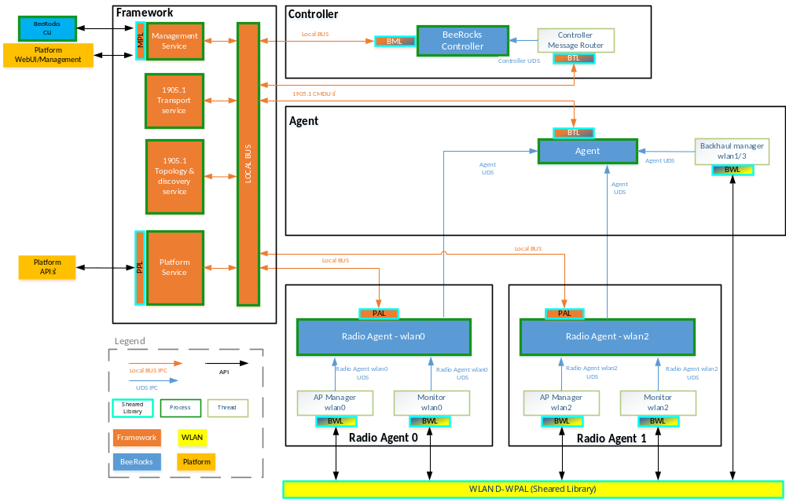
EasyMesh - Local BUS IPC

